Slide 1
( Y ?) - REACT
Speaker - Vidhyesh Vijay Patil

Slide 2
Session TakeAway’s
Importance of Front-End Development
Importance of JavaScript
Overview of Basic React Concepts
Bonus
Approach to a problem statement
Project Architecture setup
Few Best practices of React (to start with)

Slide 3
KEY POINTS in React
Open source library
Builds user interfaces for Single Page Application
Fast Learning Curve (only deals with “View”)
Reusable components
Virtual Dom
Easy to understand
Fast, Simple, Scalable
JSX Advantage
One way data binding

Slide 4
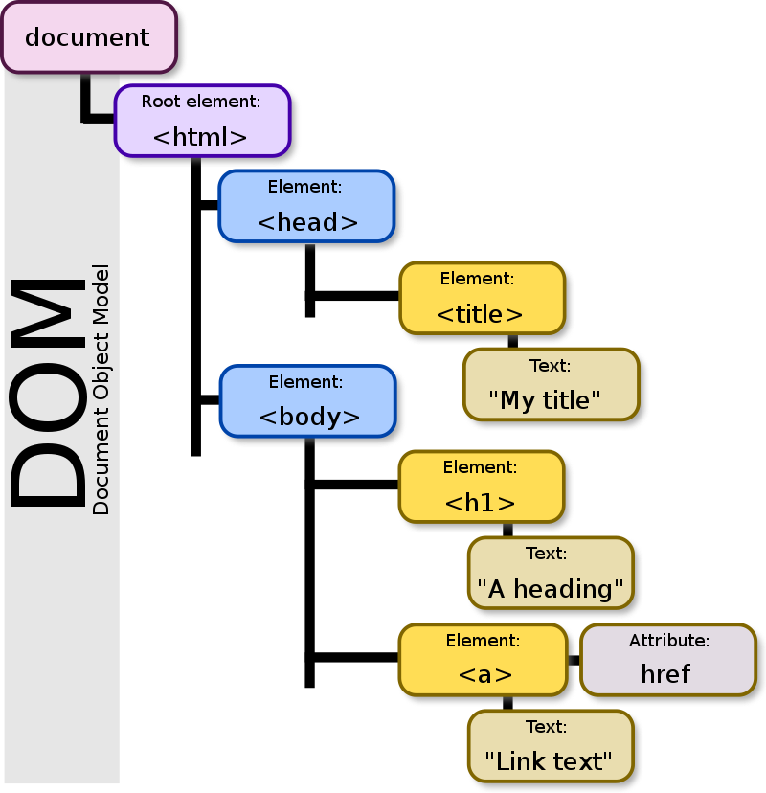
Regular DOM
Document Object Modal (DOM) it’s a standard for accessing documents on web.
In DOM, all elements are defined as objects.

Slide 5
Virtual DOM
VDOM, is a virtual representation of UI kept in memory & sync with “real” DOM with library such as ReactDOM. This process is called reconciliation.
VDOM object is the exact blueprint of real DOM object, but it doesn’t directly update the DOM.
VDOM internally uses DOM sniffing algorithm.
Please go through this link,
https://medium.com/@gethylgeorge/how-virtual-dom-and-diffing-works-in-react-6fc805f9f84e

Slide 6
Difference
Virtual DOM
Regular DOM
Lightweight.
Fast.
Process is optimized & accelerated.
Virtual representation of DOM that our application builds.
Whenever the state of our application changes VDOM get’s updated rather than the browser DOM.
Heavy.
Slow.
Process is sequentially & not optimized.
DOM is implemented in the browser & holds representation of our application.
Whenever the state of our application changes, DOM get’s updated to represent that change.

Slide 7
Difference
React
Angular
It’s a library
Virtual DOM
Light-weight
Everything is a JS approach
One way data binding
Suitable for Modern Web Development, SPA’s
Faster Learning Curve
Flexibility in development environment
It’s a Framework
Regular DOM
Heavy-weight
Typescript
Two way data binding
Large scale applications
Steep Learning Curve
Structured base framework

Slide 8
REACT Concepts
React DOM
A wrapper between React & DOM, efficiently manage DOM elements on the web page.
Important methods to know as of now,
render() - mounts the component
findDOMNode() - used to gain direct access to DOM element
https://reactjs.org/docs/react-dom.html
JSX
It’s a syntax expression of regular JavaScript.
It is faster than regular JS, performs optimization while translating code to JavaScript.
Type safe, find errors during compilation
https://reactjs.org/docs/introducing-jsx.html

Slide 9
State
It’s built-in state object, that determines how that component render & behaves.
A object where you store values, for that respective component.
https://reactjs.org/docs/state-and-lifecycle.html
Props
Props are arguments passed into React components as attributes.
Props are equivalent to parameters of pure JavaScript function.
https://reactjs.org/docs/components-and-props.html

Slide 10
Difference
State
Props
State changes can be asynchronous.
State can be modified using setState method.
State is initialized & managed by the individual component.
State are used for rendering dynamic changes within component.
Props are read-only.
Props cannot be modified.
Props are used to communicated between components.
Props are as attributes passed by it’s parent component (parent to child).

Slide 11
setState
It is used to update state object in the component & re-render the component with updated data.
It’s a asynchronous method, causes reconciliation (process of re-rendering the components tree).
It accepts a call-back method.
https://www.freecodecamp.org/news/get-pro-with-react-setstate-in-10-minutes-d38251d1c781/
render
It’s a most important & most used method of react powered component.
It’s a process of transforming your react components into DOM nodes, so that your browser can understand & display on the screen.
The render function has to return something whether it is null.

Slide 12
React Components
Class Component
It’s a type of a function, where you can access all react methods by extending it’s public method called Component.
Eg: export default class App extends Component
We could use following methods,
Constructor
All life cycle methods
Functions
State
Render
We also could accept props passed from other component (in constructor) if needed.
Functional Component
It’s a basically a JavaScript (or ES6) function which returns React element.
It must mandatory return a React element (valid JSX).
It takes props as a parameters if necessary.
It’s easier to understand, test & debug.
It gives better performance, decreased coupling & reusability.

Slide 13
REACT phase’s & Lifecycle Methods
React component’s lifecycle methods are split into 4 phases,
Initialization
Mounting
Updating
Unmounting
https://hackernoon.com/reactjs-component-lifecycle-methods-a-deep-dive-38275d9d13c0

Slide 14
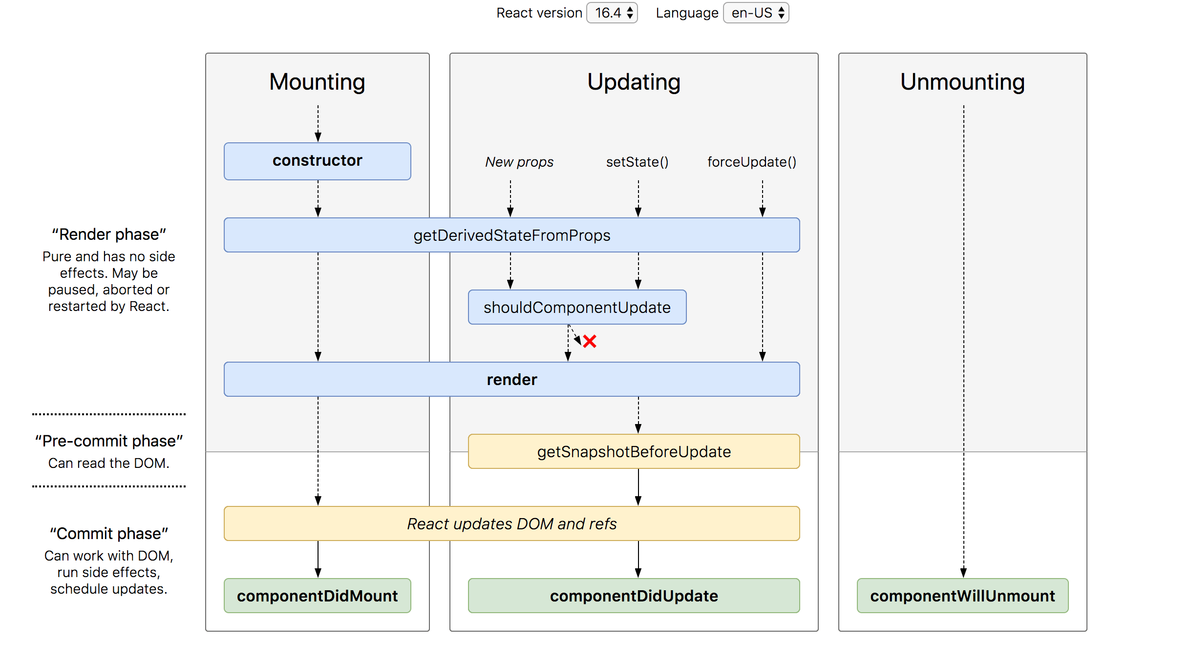
Lifecycle Methods

Slide 15
ANY QUES?TIONS ?

Slide 16
!! THANK YOU !!

